Slide 1
Total Misdemeanors by precinct from 2000 to 2015
Same, but normalized by precinct area

Slide 2
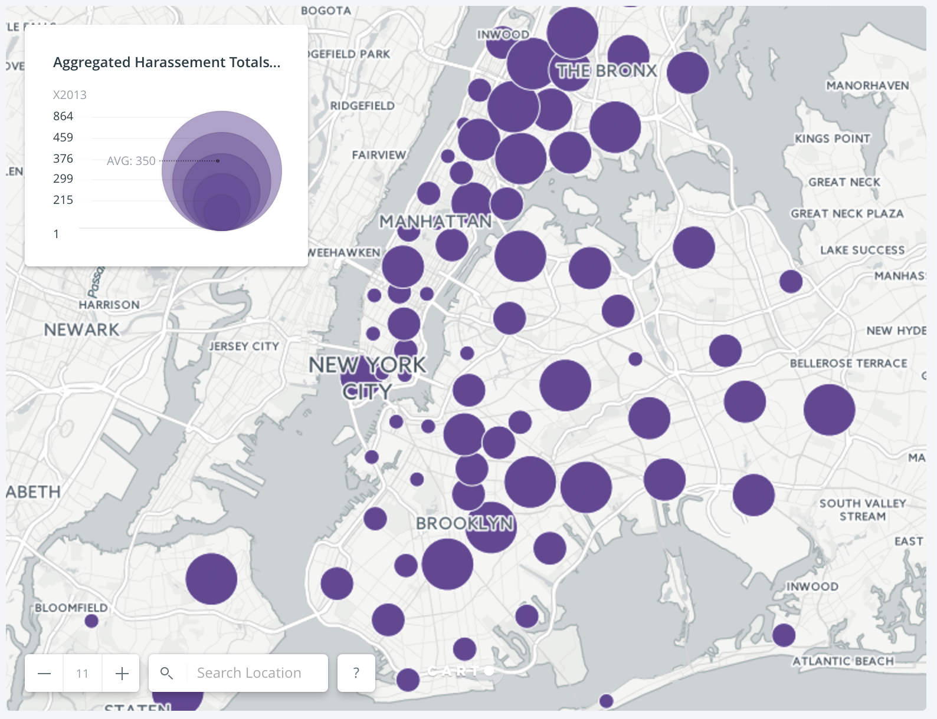
Aggravated Harassment Totals by Precinct 2013 Aggravated harassment in the second degree, occurs when a person intentionally acts to harass, threaten, annoy or alarm another person, using a telephone, telegraph, the mail or any form of written communication, including electronic means.

